Slide 1

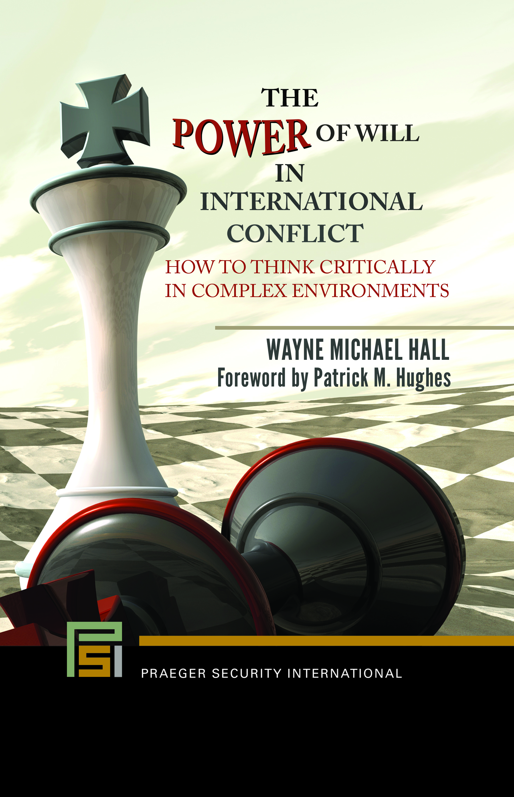
Notes:
‘Will’ is the central idea of conflict. Struggles to impose one’s ‘will,’ or deny an enemy’s imposition is the basis for achieving ‘will to power.’ All adversaries striving to impose their ‘will’ on others share some interesting commonalities. For example,
People want to win; power is often the focus of struggles over winning and losing.
People do not want to lose so, in some cases, their strategy becomes simply to avoid losing.
People impose their will on others for one or more desired outcomes.
Targets of impositions of one’s ‘will’ either capitulate or resist. They sometimes wait for another day.
Combatants always employ a calculus and thought models when thinking about how to attack or resist. A favorite over time has been ends, ways, and means.
If a resister refuses to capitulate or strike a ‘deal,’ conflict usually occurs.
This talk is about a book on will. It is—The Power of Will in International Conflict, and it provides ways to think about ‘will.’ In fact, this book provides the intellectual foundation of ‘will,’ and methods for further study of this great phenomenon.

Slide 2

Purposes
Inform the audience of some of the ideas in my book about ‘will.’
Improve thought, strategy, planning, decision making, action, assessment, and adaptation.
Improve both effectiveness and efficiency of elements of national defense.
Increase the probability of favorable outcomes in contests of ‘will’.
Notes:
Here, you find the purposes for this discussion.
A void exists in our ‘how to fight’ doctrine. It is an inexplicable lack of a definition and discussion of ‘will.’
We have theories of geopolitics, global economics, and international relations—so I ask—why not theories and doctrine on the role of human ‘will’ in violent and nonviolent conflict? Why not improve our national defense with a learned concept of ‘will.’
Thus, I designed this book to include military decision-makers, strategists, planners, intel analysts, senior military leaders, government policymakers, and political decision-makers. Decision-makers of all ranks and positions must learn about ‘will’ and its importance to effective decision-making.
Improvement in decisions directly connects to an improved probability of positive outcomes in mental and physical combat in all domains and levels of conflict.

Slide 3
Notable Failures Attributable To a State of Being Unschooled About 'Will’
Barbarossa (June 1941)—Germany
Typhoon (October 1941)—Germany
Pearl Harbor (December 1941)—Japan
Korean War (1951-1953)—US
Dien Bien Phu (1954)—France
Viet Nam War (1954-1975)—US
Iraq (2004-2008)—US
Afghanistan (2001-2021)—US
Notes:
The visual lists notable historical failures with the subject of 'will.' In these cases, policy makers, planners, and decision-makers displayed a distinct obliviousness to ‘will.’
My book about ‘will’ offers solutions to such failures of thought. It enables one to acquire a breadth and depth of thought sufficient to impose their ‘will’ on any adversary competing in any context.
With deep thinking about ‘will,’ one can anticipate an enemy’s moves and counter-moves. The goal is, of course, to stimulate one’s thinking into a state of higher quality of foresight and comprehension than any adversary.
With good thinking, one can attack their foe’s strategies and plans at inception. Recently I wrote a paper on this subject in The Wavell Room, published in two parts last January—Thinking Like Sun Tzu.
While the notion of ‘will’ is singularly powerful, merging ‘will,’ technology, and organizational design allows one to approach ‘will’s’ zenith of strength.

Slide 4
Challenges
In history, practitioners and scholars of conflict speak of ‘will’ ethereally and typically pathetic mental effort.
Historically, ‘will’ appears as the output of conflict, but not as a powerful mental function before the fight.
‘Will’ is neither defined nor discussed in US military doctrine.
Putting ‘will’ into practice—demanding.
With its curious absence in conflict theory and doctrine, ‘will’ must be brought into the light of day and animated.
Notes:
If mentioned at all, ‘will’ appears as ethereal, vague, and superficial.
Thus, I went to history to find the thinking that caused the outcomes of 'will' to appear. For example, I read Caesar’s Gallic War, Scullard's book Scipio Africanus, and Glantz’s book Operation Barbarossa, but what I sought wasn’t there. I sought how attacking entities would be accurately thinking about his ‘will,’ the enemy’s ‘will,’ and the operational context, while preparing for a fight.
Certainly, ‘will’ is a complicated subject. It is challenging to understand let alone to put into practice. Regardless, it must be understood. It must occupy a preeminent place in the Military Decision-Making Process or (MDMP) one learns in Schools of Advanced Military Studies (SAMS), War Colleges, and Joint and Service command and staff colleges (CSCs). Students must study ‘will’ not only to learn its basic premises but to understand its intricacies.
In my concept of 'will,' I’m not just talking about our typical use of ‘willpower,’ meaning self-control of one’s impulses and actions. Nor am I talking about free will, (the power of acting without the constraint of fate). No, to my way of thinking, such descriptors help us understand life-force, the epicenter of ‘will to power.’ From it springs a model of 14 elements, which we’ll momentarily discuss. This book focuses on ‘will to power.’
In this view, one’s thinking, planning, actions, assessment of outcomes, and adaptations serve as the means of influencing the desire for power first appearing in life-force.

Slide 5

Insights
‘Will’—of critical importance to the Military Decision-making Process.
‘Will’—should cut across doctrine, technology, organizational design, training/education, materiel, leadership.
Derivatives:
By building ‘will’s’ presence in doctrine, one overcomes certain deficiencies:
  A lack of thinking skills to actuate ‘will’
  Technology to enhance ‘will’
  Organizational design to support ‘will’
Notes:
Ignoring ‘will’ diminishes the quality of decisions. But this situation is even more egregious than diminution of 'will' through neglect. A failure to understand ‘will’ diminishes clarity and usefulness of one’s doctrine, organization, training, and education, materiel, and leader development.
Think about the derivatives in the visual. It is essential to develop the technology to empower the ideas in this book to unleash a tremendous energy.
Taking the time and expending the mental effort to
read the book enables one to impose their ‘will’ on the adversary while deftly denying his efforts to impose his ‘will’ on you. This duality comes from Clausewitz. It is always present and influential.
Thought is the basis for winning bouts of ‘will.’ With thought, one can master the intricacies of ‘will.' More specifically, through thought, one can comprehend the enemy’s aims, goals, objectives, resources, constraints, possible strategies, possible tactics, and so on. Each has degrees of vulnerability and potential for exploitation.
But technology must help. It is the key to attaining ‘will to power.’

Slide 6
Why Be Concerned?
Warfighting potential is suboptimized.
Missing a window of opportunity for winning bouts of ‘will’ w/Chinese, Russians, Iranians, North Koreans, Drug Cartels.
Requires study, understanding, application—all military decision-makers, civilian policy-makers.
Requires advanced technology.
Notes:
Logically, one can ask, why the concern?
Quite directly, the answers to the absence of detailed knowledge about 'will' include: 1) our warfighting potential is suboptimized, 2) we’re missing the opportunity to be ahead of our adversaries, and 3) we are missing the potential to merge thought, machines, and ‘will’ into a whole of great strength.
A lapse in thinking means we are missing the connection between advanced technology and ‘will’s’ key actions. I’m speaking of AI, data mining, synthetic environments, clustering, augmented reality, and advanced avatars for wargaming an adversary’s wargaming, to name a few.
Understanding the basics of ‘will’ enables the following benefits: 1) anticipate an opponent’s ‘will,’ 2) resist an enemy’s impositions of ‘will,’ 3) anticipate an enemy’s counter-moves, 4) seek advantages by winning the knowledge war, and 5) find and strike ‘that which is most important’ to your enemy. He attempts to do likewise.
We must prepare to fight and win against opponents armed with understanding of 'will,' high-powered thinking, modern organizational design, and advanced technology.

Slide 7
Definition of ‘Will’
‘Will’—force—moral, intellectual, physical—that impel action to accomplish goals, objectives, and strategies. ‘Will’ always includes capabilities and strength of motive.
This definition is a combination of thoughts coming from my study and from Dr. Hal Winton’s critique of my book, The Power of Will in International Conflict (Santa Monica: Praeger Security
Notes:
Here, you see my definition of ‘will.’ Any struggle for dominance of ‘will’ occurs in moral, intellectual, and physical domains. Purpose, strength of motive, and capabilities prove of great importance in planning, decisions, and execution of imposition operations.
The definition extolls the importance of emotion in conflict, elements such as sacrifice, passion, determination, perseverance, strength of motive, and so on.
Applying ‘will’s’ intricacies can yield a certain primacy in conflict. As a maxim, I submit to you this idea—to win in conflict, one must attack, control, and bring to submission, their opponent’s essential elements of ‘will,’ its intricacies, and the layers of connected knowledge that underpin this phenomenon.
Of course, one must protect their ‘will’ and its intricacies while attacking their foes.’ How well they do this dictates the outcomes of conflict.

Slide 8
Desire
Resolve
A recursive process
Life Force
Perseverance
Capabilities
Disadvantage
Assessment
Passion
Purpose
Action
Imposition
Sacrifice
Strength
of
Motive
Advantage
Adaptation
Determination
“Will” Thought Model
Proprietary Information and Private Property.
Property of Wayne Michael Hall. All Rights Reserved.
Copyright 2007, Wayne Michael Hall
Notes:
This visual constitutes the book’s basic model of ‘will.’ It has 14 essential elements—some physical, some intellectual, some moral.
Until one travels the road of ‘will,’ they cannot know and develop ideas, concepts, and challenges that accompany the notion. And with an absence of good thinking, they can soon become overly burdened by detailed knowledge and relationship layers extant within each whole of ‘will’ without seeing the whole itself.
One must study ‘will’ in depth to to attain specifically tailored advantages over the enemy. This includes approximating how he thinks and plans, learning the role of culture, cultural rules, anticipating their influence on action models, determining his willingness to sacrifice, and finding his degree of determination.
In addition, we must—1) seek to answer the question of the basis of the enemy’s determination, 2) conclude why an opponent appears willing to sacrifice, 3) settle on why he fights to persevere against all odds, 4) resolve what comprises his strength of motive, and 5) use the answers to these questions to focus one’s attacks.
Know too, the appearance, power, and influence of these elements come and go. They sometimes don’t appear until sensitive variables or circumstances per se cause their awakening and appearance.

Slide 9

One Must Discern What Truly Matters In Any Struggle of ‘Will’ To Power
Consider culture, cultural rules, rule-driven action models that guide an enemy’s decision processes
Power, sensitive places, things, statuses, pride.
Operational contexts.
  Non-linearity, co-evolution, adaptation.
  Sea of data.
Centers of Gravity, decisive points, pressure points.
Duality—recognition thereof.
Self-interest.
Strategic aim, goals, objectives, strategies …
Notes:
To understand a conflict, one must know the adversary’s culture. There, one finds his enemy’s self-interest, and thirst for power, and acquires his aims, goals, objectives, and strategies.
These aspects of war exist as an opaque membrane enclosed in a cultural cocoon. High-quality knowledge allows one to pierce this cocoon. Such knowledge can only come with study.
Often, however, one needs to consult with the people of a culture to understand and exploit the culture in question. Such knowledge leads one to discover an enemy's centers of gravity, decisive points, and pressure points, from two perspectives—one’s own and their enemy’s.
In any fight, one must understand and prepare for the appearance of nonlinear systems. The recipient of their meddling can suffer surprise effects whose causes and links often prove mysterious.
As one scratches their head and asks why something unforeseen happens, it is a person endowed by study and knowledge of complexity theory and nonlinearity who answers the question. It is the appearance and interference of nonlinear systems, always alive, mysterious, and highly influential that lay at the nub of causation for turbulence and change inherent to modern conflict.
Along with turbulence and change, nonlinear systems incubate and hatch unexpected data flows that often wreak havoc on one’s efforts to perceive, think, plan, decide, execute, assess, and adapt.

Slide 10
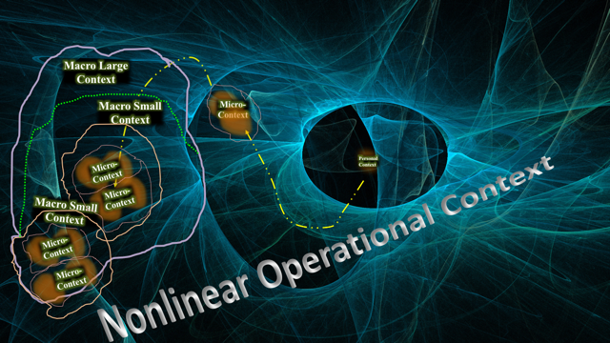
Nonlinear Systems
Micro- Context
Personal Context
Linear Systems
Proprietary Information and Private Property.
Property of Wayne Michael Hall. All Rights Reserved.
Copyright 2007, Wayne Michael Hall
Notes:
In this visual, one finds five kinds of sub-contexts. They are an integral part of the interwoven and influencing actions inherent to any operational context housing a conflict. By context, I mean—the set of influencers that surround, permeate, and influence the outcomes of clashes of ‘will.’
I’ve expanded on traditional views of operational environment to include linear and nonlinear systems and its many characteristics, wanted and unwanted data flows, and not only collisions of physical things, but also the collisions of social media, minds, electrons, narratives, thoughts, and ideas.
Aggregation theory helps people understand the expansion and contraction of opposing forces. It involves the conjoining of two or more aggregates, which can be people, machines, or organizations. Aggregations come forth too in a populace. For example, in a given context one could find small inputs leading to large outputs such as a small demonstration turning into a huge riot as many disparate parts congeal into a whole of like-minded people.
Consider what you see in this visual as: 1) an inclusive whole that is the macro context per se, 2) a personal context, 3) a micro-context that is an aggregate (or two or more people), 4) a small-macro context that is a small aggregation (or two or more aggregations), and 5) a large macro-context, a larger aggregation of multiple aggregations of people and things.
Groups of aggregates and aggregations and their contexts can turn into even larger aggregations knitted together via a sort of glue that binds doctrine, purpose, common views, ideology, aims, goals, and strategies into a large whole.
See next slide for continuation of thoughts about this subject.

Slide 11
Nonlinear Systems
Micro- Context
Personal Context
Linear Systems
Proprietary Information and Private Property.
Property of Wayne Michael Hall. All Rights Reserved.
Copyright 2007, Wayne Michael Hall
Notes:
In these expressions of context, struggles of ‘will’ occur. Such fights of ‘will’ appear by way of colliding individuals, aggregates, and aggregations. Thus, one’s mind must grasp the nature and composition of competing aggregations and their surrounding contexts in question. And one is wise to anticipate circumstances that could whip up wanted and unwanted data, bringing turbulence to the contexts that houses competing entities moving within and through them.
In contested operational contexts, one grows comfortable with an ancient phenomenon—the unity of opposites. Thus, any context and its occupants may be physical and nonphysical, tangible and intangible, visible and invisible, noisy and silent, and so on. One comes to conclude that contestants in conflict must always realize the importance of contextual advantages and disadvantages coming to them and their foe from their view and their enemy’s.

Slide 12
Centers of Gravity
Pressure Points
Decisive Points
Does One Know ‘How to Think’ Like The Enemy Thinks About ‘Will’?
Notes:
As one studies future operational contexts, they find the importance of knowing and understanding an enemy via his thinking, planning, and his strategy.
But do I realistically think about the enemy and how he thinks about me? The answer is problematic because of the rigor of thinking one requires to think like the enemy thinks. As examples, one must know 'how to think,' 'what to think,' views of subjectivity and objectivity, facts, truths, bias errors, logic errors, assumptions, and quality control.
Further, people must understand the adversary’s culture-influenced thinking processes. They must grasp the enemy's rules and how they influence his decision-making processes, action-models, action per se, assessment, and adaptation, as he ponders his adversary—you!
He acts, assesses, and adapts via recursive ISR feeding his decision-making. This is a necessary action one can exploit. Always, he seeks to act faster and more effectively than you. This status comes via recursive ISR and then cognition yielding analysis, synthesis, and fast, effective decisions. It enables him to seize and hold the initiative and momentum.
Thus, in our study of ‘will,’ one must answer these questions: 1) Do I truly know my adversary? 2) Does he know me? 3) What comprises his ‘will to power?’ 4) What is the thought model he uses to think not only about his enemy’s ‘will,’ but also his enemy’s view of his ‘will?’ 5) How does the enemy engage in recursion, assessment, adaptation, and new decision? 6) How do I seek, find, and influence this essential cycle? and, 7) How does—he think—I think—he thinks?

Slide 13


This Is My Enemy In Deep Thought
What Is He Thinking?
Notes:
Here is the enemy. I seek to control his mind and influence his decisions. Clausewitz helps us understand this task on page 77 of Michael Howard’s and Peter Paret’s version of On War, when he says:
“War, however, is not the action of a living force upon a lifeless mass. Total nonresistance would be no war at all …it is always the collision of two living forces. The aim of waging war … must be taken as applying to both sides…Thus I am not in control: he dictates to me as much as I dictate to him.
I discover that I must answer many questions as I attempt to think about as I ponder how my enemy thinks. Here are ten of those questions:
1. Does my enemy think his purpose to be superior to mine?
2. Does my enemy think his capabilities to be superior to mine?
3. Does my enemy think his motives to be stronger than mine?
4. Does my enemy think his advantages superior to mine?
5. Does my enemy think he has hidden his disadvantages?
6. Does my enemy think his perseverance stronger than mine?
7. Does my enemy think his determination superior to mine?
8. Does my enemy think his willingness to sacrifice superior to mine?
9. Does my enemy think his passion superior to mine?
10. Does my enemy think his ability to impose actions superior to mine?

Slide 14
Proprietary Information and Private Property.
Property of Wayne Michael Hall. All Rights Reserved.
Copyright 2017, Wayne Michael Hall
Notes:
Next, let’s think about the visual above. I venture to say, people in any struggle of will follow some aspects of this sequence.
This model reflects an emphasis on co-evolution and adaptation with its cultural rules, culturally influenced action models, culturally biased assessment of outcomes, and subsequent adaptation. Co-evolution always involves an organism acting, assessing their outcomes, learning, and adapting.
Please recall that each competing entity in a conflict attempts to perform their tasks better and faster than their adversaries. They strain in a race to the swift that facilitates a successful imposition of their will on their foe who is attempting to do likewise to them.
The model helps one know where, how, when, and in what force to attack their opponent in mental combat. It also helps one anticipate and thwart an adversary’s attack.
Along with physical outcomes of this process, one can use the model to attack their enemy’s ‘will’ by attacking his mind, how he thinks, his assumptions, decisions, actions, assessing, and adapting.

Slide 15
Nonlinear Operational Contexts – Duality Always in Mind
Proprietary Information and Private Property.
Property of Wayne Michael Hall. All Rights Reserved.
Copyright 2017, Wayne Michael Hall
Notes:
This visual depicts two sides—red and blue—fighting one another. It speaks to conflict among human beings, their ideologies, their organizations, machines, governments, and nations.
Here you see a theoretical pendulum. It swings back and forth, but not in a smooth arc. Instead, the pendulum gyrates. It travels first to blue, then to red, then to the middle point of the arc.
For example, I ride the pendulum, drop off on the adversary’s side, enter his mind, learn how he perceives, thinks, and plans. I seek to ascertain his aim, goals, objectives, and strategies. I seek his model of ‘will.’
I thus find myself continuing to think deeply in order to determine the power and energy of each element of three wargames—1) how he thinks about us, 2) how he thinks we think about him, then, 3) how he thinks, we think, how he thinks.
I determine the elements of ‘will’ having the greatest probability to appear. I consider the value in attacking one, two or all 14 of the elements. And I deduce elements having the greatest probability of remaining dormant. I recognize how quickly these elements can change to become active.
From this work, I anticipate the adversary’s strategic aim, goals, objectives, resources, constraints, strategies, and so. Specifically, I determine how the enemy plans to impose his ‘will’ via actions in all phases of a struggle.
I learn about the internal workings of his intelligence systems including if he uses any one or all of these methods of thinking—analysis, synthesis, holism. I surmise how he evaluates assessment data, how he learns, how he adapts, as he tries to adapt faster and better than me.
He tries to think as I think about how he thinks when wargaming to beat his own plan. I realize that he could come to learn how I could beat him, often by affecting ‘that which is most important.’ This knowledge provides me with the capability to change.

Slide 16

Technology Needs
Smart data to intercept, redress en. recursion & assessment data
Neural Networks
Data mining
Synthetic contexts
4 connected aspects
1. Individual
2. Micro
3. Macro-small
4. Macro-large
AI and modeling I—an approaching vision the enemy is about to render into his life-force & thinking
Holograms—to represent the adversary
Avatars for wargaming the adversary’s wargaming
Software—quality control—assumptions, beliefs, claims, evidence, facts, truths, logic & bias errors
Models & simulations—replicate cultural rules, action models, cultural influence on assessment & adaptation
Cluster Analysis
Outliers
Patterns
Anomalies
Tendencies
AI and modeling II—
Tracking, identifying strengths, weaknesses of friendly vs enemy ‘will’ model from the book
Notes:
I have thought about some technology requirements for immediate and longer-term outcomes.
One is smart data to intercept, manipulate, redress, and deposit manipulated data into an enemy’s co-evolution and adaptation decision-making cycles. Smart data means developing data entry points intelligent enough to make some types of decisions on collected data immediately, without requiring processing via a centralized system. Smart data would start acting upon the enemy’s data at the collection point.
It would be productive to have sophisticated synthetic contexts to support wargaming and to understand pluses and minuses extant in the operational context. They could come from the gaming world. These contexts would represent contextual realities and portray aggregations in 4 dimensions that change with action and time. It would bee helpful to have such contexts randomly insert nonlinear activities, such as friction, randomness, chance, and sensitive variables. Synthetic contexts would require random appearances of spurious data mixed with valuable data, causing a constant changing of conditions for adaptation.
To outsmart a foe, possible tech enhancers could include: artificial intelligence, data mining, cluster analysis, visualization, virtual reality, holographic representations, and surrogate travel in virtual reality to enter my enemy’s mind via his databases, video, decision tools, and emphasis. I want a virtual foe to wargame against to learn how to attack his plans and strategies at their inception.
More specifically, I would like to have culturally programmed avatars for 1) wargaming the adversary’s activities, and 2) wargaming the adversary’s wargaming. Specifically, I’m speaking of; Artificial Intelligence; Generative Adversarial Network (GAN); Deep Learning; Machine Learning; Neural Networking; and Cluster Analysis.
Another requirement involves models and algorithms that learn the enemy's culture, rules, action models, and thought models. One of the models must involve quality control to find my thinking errors and my adversary’s.
A great contribution would be a system of systems. It would include data mining, neural networks, and cluster analysis. It would also include models & simulation of actions tracking strengths of will’s essential elements. These models with their visualization would be trained to track capabilities, advantages, disadvantages, determination, passion, etc., all to understand the status of volatile states of the 14-element model of ‘will’ in the book.

Slide 17
Vision
'Will’—it is the central idea of conflict, and our warriors must understand, study, and exploit it.
Technology empowers ‘will,’ and organizational design supports both.
People recognize ‘will’ as the starting point of departure in any effort to think strategically. Will’s definition and explanation go into Joint doctrine.
‘Will’s’ intricacies and many connected layers ascend to prominence in the MDMP.
Students study ‘will’ in CSC, and War College curricula.
Notes:
In closing, let’s consider the ideal:
The defense establishment accepts 'will' as the central idea of conflict.
Doctrine defines, explains, and enables exploitation of ‘will’s’ power. We aspire to create synergy among ‘will,’ technology, and organizational design.
America’s scientists and technologists develop technology to support the thinking to exploit ‘will’ to action. This effort starts quickly with off-the-shelf technology, following a tiered approach, while introducing existing or new technologies from what we learn.
With a combination of the human mind and machines, one finds America’s warriors successfully imposing their ‘will’ on the panoply of adversaries we face. This occurs not just in a physical sense, but also in intellectual, emotional, and moral senses.
One understands the opponent’s ‘will’ to win. Thus, one focuses ideas and plans to defeat the enemy's plans and strategies at their inception. Determining that which is most important reigns supreme in such battles of ‘will.’
Decision-makers, strategists, planners, and intelligence analysts learn ‘how to think’ about ‘will’ to power’ using the book and its 14-element thought model, explanations, and definitions.
‘Will’ becomes central to the curricula of CSCs, SAMS, and War Colleges.
The implementation of ‘will’ and its taxonomy comes to life in the very near term. We move ideas and theories of 'will' into practice. This transfer occurs via knowledgeable people, empowering tools, virtual knowledge environments, and connections to advanced collection and advanced analysis nodes.
People recognize 'will' as critically important for making good decisions. As such, the duel between opposing decision-makers starts within the mind of each as they rigorously consider their 'will' relative to their opponent's 'will.'
As a parting thought, purposeful preparation, deep thinking, life-long learning, empowered by technology can lead to a continuing, learning, and aggressive state of intellectual readiness. It is this state we create and sustain for winning in mental combat during the wars of wits approaching threatening America’s well-being.

Slide 18
Adversary Cell
How he thinks;
Pressures (28);
Critical thinking;
13 element model;
Character;
World view;
Considerations Cell
Will-41 Considerations;
Discern what truly matters;
Value of objectives
Wargame Cell
Ride Wild Pendulum;
Wargame en. Wargaming;
Atk. his strategy at inception
Mind’s Eye Cell
Think as enemy thinks we think;
Role of data;
Importance of knowledge;
Decision-making
Culture Cell
Culture per se;
Cultural rules;
Action models;
Influence on thought;
Influence on his ‘will’ model
Organizational Design Needs—Deep Think Cells
Critical Thinking Cell
His/my logic & bias errors;
22 elements;
Battles of quality
14 Elements of ‘Will’ Cell
Mine/His;
Importance;
Dormant/Active;
Vulnerabilities;
Appearances
Operational Context Cell;
Linear systems;
Nonlinear systems;
Sensitive variables;
Icons
Enemy Strategy Cell
Elements;
Active/dormant elements;
Aim, Goals, Objectives, Strategy, etc.
CAS Cell
Nonlinearity;
Co-evolution;
Adaptation;
Placement in Decisions

Slide 19
How People In Extremis Think—A Theory
Think
Decide
Assess
Collect
Synthesize
Learn
Adapt
Perceive
Evaluate
Recompose
Observables
Act
Plan
Proprietary Information and Private Property.
Property of Wayne Michael Hall. All Rights Reserved.
Copyright 2007, Wayne Michael Hall
Notes:
Next, let’s think about the visual above. I venture to say, all people in struggles of will follow some aspects of this sequence if they hope to be sufficiently organized and sufficiently thoughtful to design and aggressively seek aims, goals, objectives, and so on. The model can have either more elements or some could be taken away. The use always modifies to bring the model from theoretical to practical.
This model reflects my emphasis on co-evolution and adaptation with its cultural rules, culturally ruled action models, and culturally biased assessment of outcomes and subsequent adaptation. Co-evolution always involves actions, assessing outcomes of action, evaluating outcomes, learning, and adapting. And, recursion is at work and performs a critical function. It provides assessment data via intelligence collection back to its brain. Each competing organism attempts to perform such tasks better and faster than their adversaries. They strain in a race to successfully impose their will on their foe who attempts to do likewise to them.
The sequencing of necessary elements in thought come out loud and clear. We go through some kind of a thinking journey in any struggle of wills. What you see in the visual above is how I imagine people to think in such a struggle. Thus, in my view, one must use this model to hone, if not to guide their thinking. More importantly, the model helps one know where, how, and when, and in what force to attack their opponent in mental combat and, if on the defensive, how to anticipate and thwart an adversary’s attack. The model advocates attacking one’s opponent’s thought to action processes and the steps necessary to impose their will. To win a war of wits against a tough, smart, canny enemy, I suggest that one must use a semblance of this model.

Slide 20
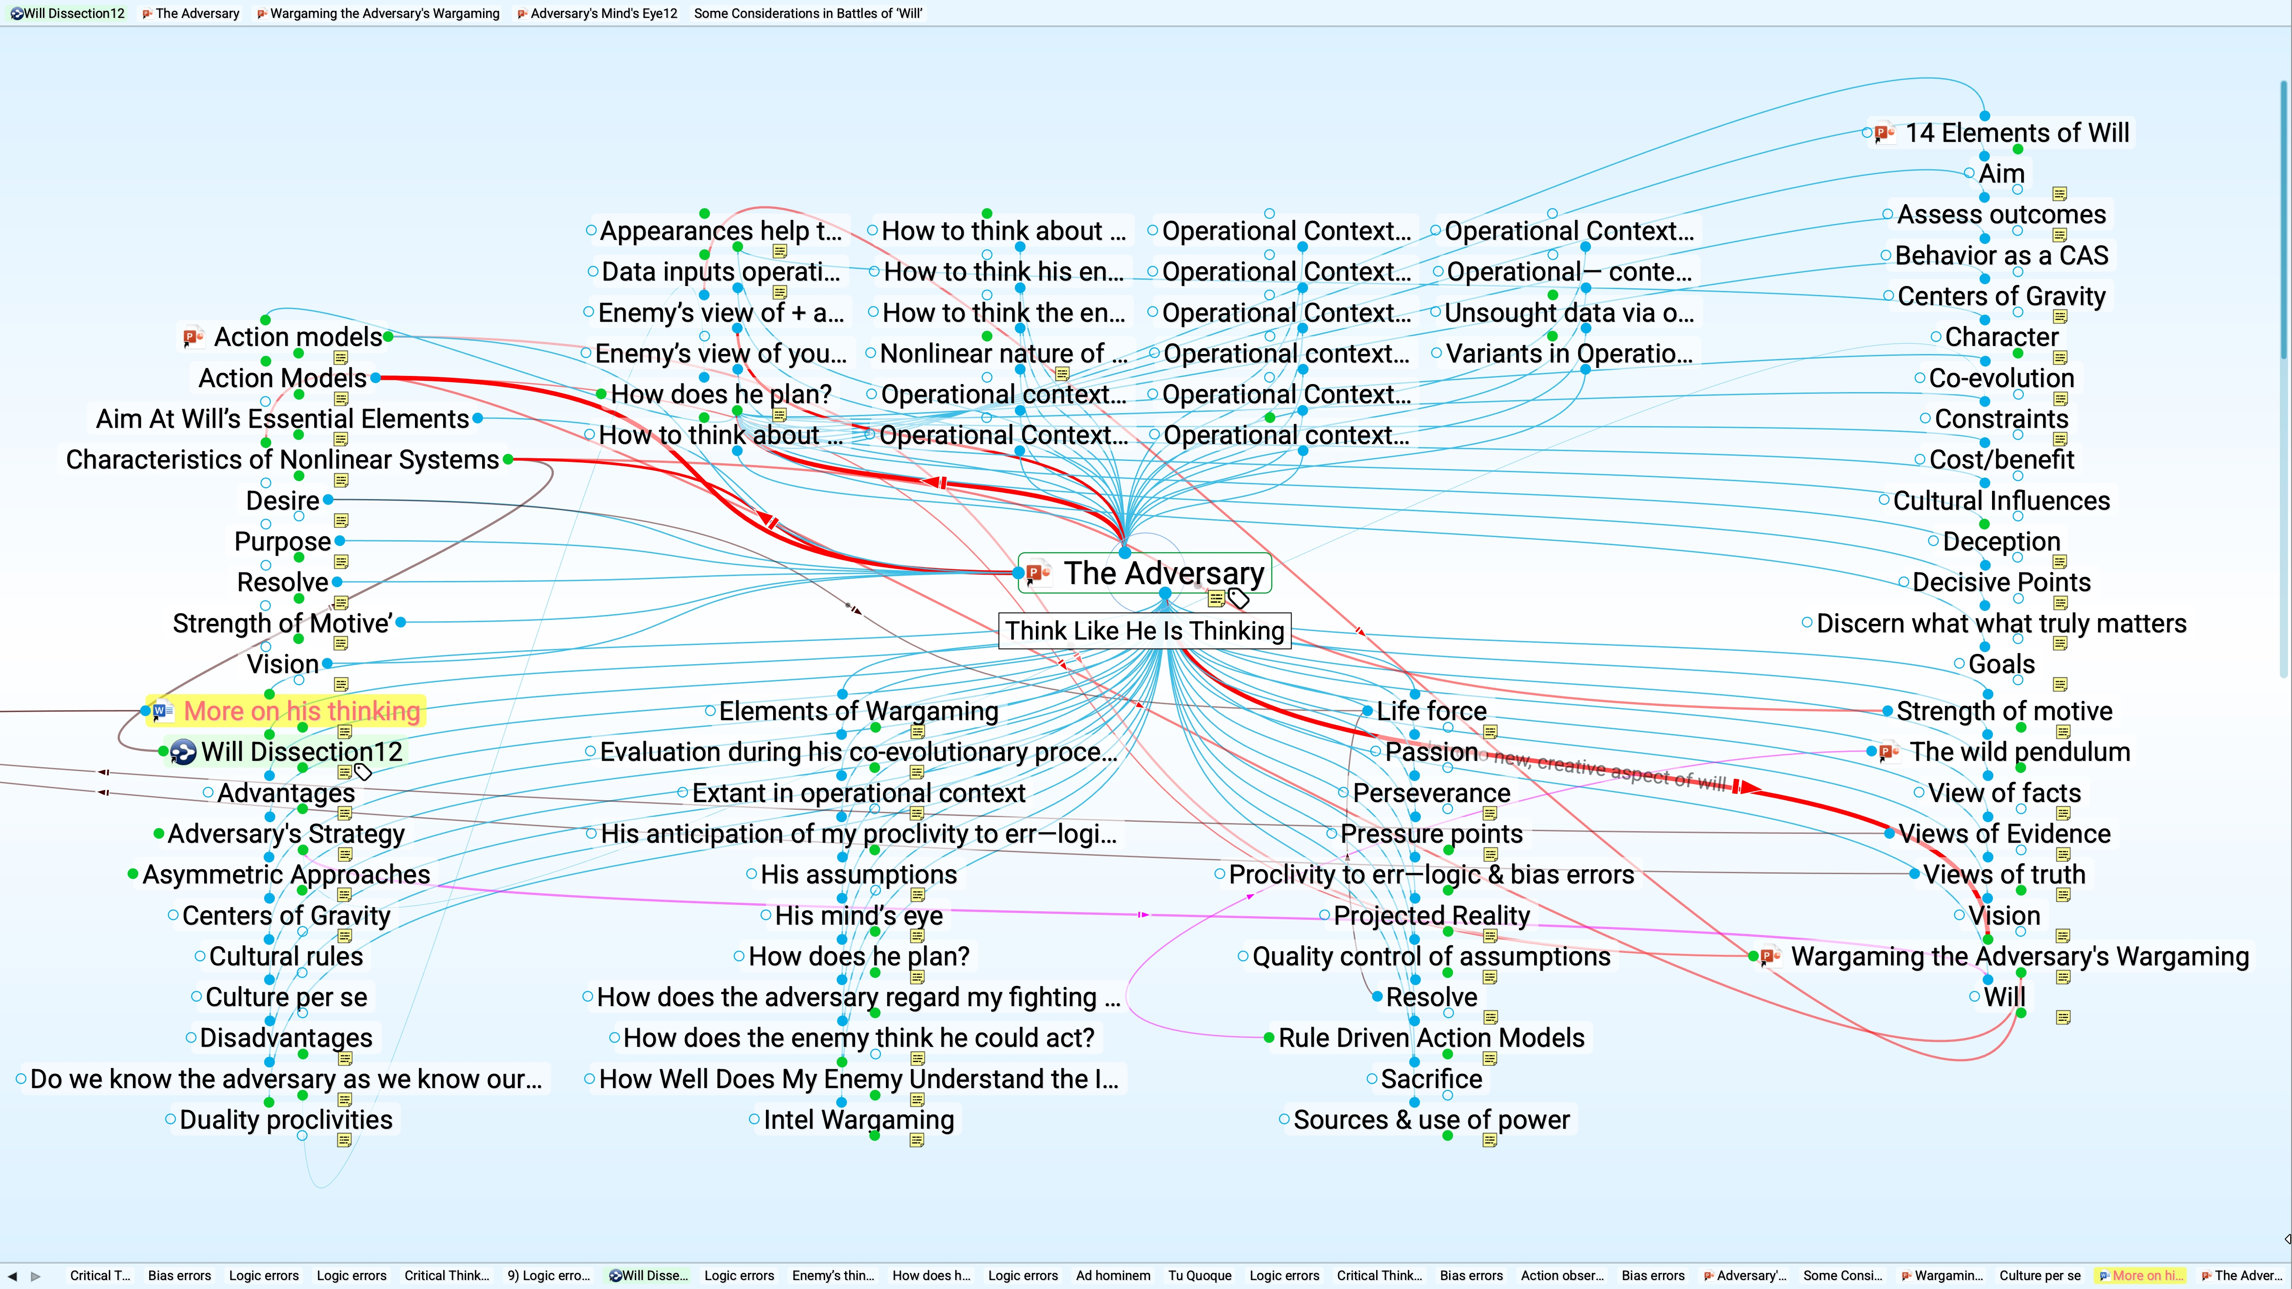
Aspects of the Adversary in Wargaming
The Adversary

Slide 21
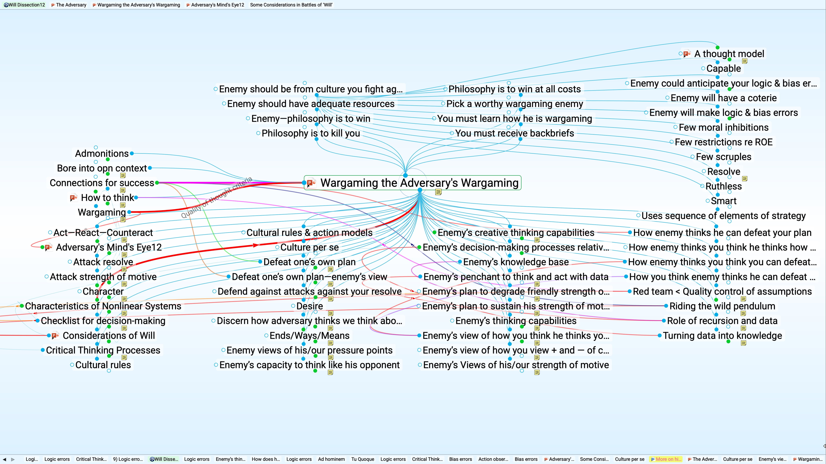
Considerations For Wargaming of This Nature
Wargaming The Adversary’s Wargaming

Slide 22
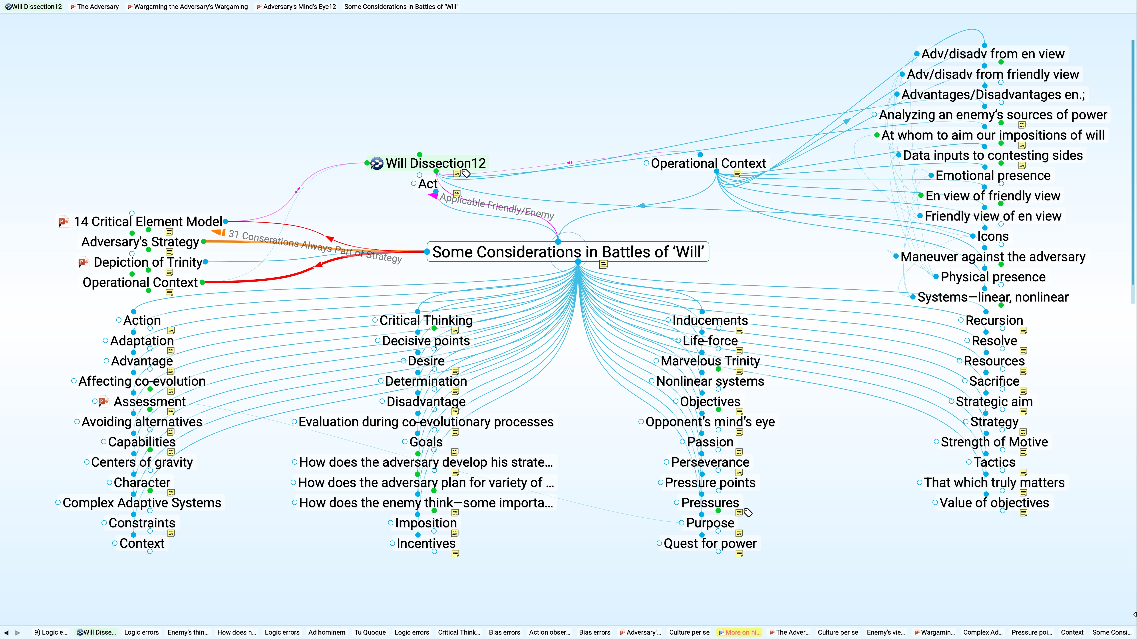
Considerations
Of Will

