Slide 1
Short Summary Visuals for Senior Decision-makers:
Reflections On “Will”
Wayne Michael Hall
Proprietary Information and Private Property.
Property of Wayne Michael Hall. All Rights Reserved.
Copyright 2007, Wayne Michael Hall

Slide 2
“Will”—A Rudimentary View
Desire
Volition
Life-force
Resolve
Desire
Volition
Life-force
Resolve
Side 1
Clash
of
“Wills”
Side 2
A
C
T
I
O
N
A
C
T
I
O
N
“Will”
Purpose
“Will”
Purpose
Imposition of Will
Counter-imposition of Will

Slide 3
Why Must I Must Care About “Will”?
“Will” = essence of conflict. Do not fear. Study. Learn. Understand. Use for advantage.
Intellectual vacuum exists—it involves “will’s” meaning, importance, intricacies—
Fill this vacuum or your adversaries will fill it and screw you to the wall.
In “will” one finds the central idea over which mankind has been fighting—time immemorial; secrets abound in this great phenomenon.
Understanding the ‘Wolf of Volition’ via my thought models provides advantages over an adversary.
Imbuing people with understanding provides wherewithal to win in mental combat.
Über thinkers and thought pilgrims—plan, execute, assess, adapt, and, of course, win in mental combat.
Fathoming “will” allows striking first to seize the initiative and to employ other advantages.
Grasping “will” allows you to outthink your adversary and thereby anticipate and thwart his life-force at its inception.
Comprehending “will” requires a threefold commitment: 1) know important aspects of adversary’s mind, 2) know your operational context, and 3) be agile—unexpected chance events always appear on the stage of conflict via co-evolution and nonlinearity.

Slide 4
“Will”—What Does It Mean?
“Will” is a concept, a theory, indeed one of the most important but most neglected theories ever conceived.
In the most understandable way I can conceive, “will” means—one person or party imposing their desire, or conceived outcome, on a resisting opponent.

Slide 5
“Will”—More Clarity
“Will” appears in one’s mind as an oft powerful, all-permeating presence that clarifies and often releases and empowers one’s sublimated desires to either control that which another person possesses or to take what they own, such as: wealth, land, power, beliefs, accesses, organization, hill-top, freedom of movement, and so on. This impulse—the desire—once rationalized and articulated, enables its originator to judge the degree of resolve at play relative to the resolve of their adversary, or people whose “will” could be aroused to later involvement.
If capabilities and strength of motive prove sufficient via assumption analysis and synthesis, the concerned desire can infect and shape a sequence at the very heart of “will”—a transformation from passive, chameleon-like, volition to active life-force, and a subsequent shift into reality and consciousness via a host of possible impositions of action to satisfy desire.
Resolve and sacrifice empower one’s rationale and emotions for said appearance to enter the human ‘keep’ where the hungry, potentially powerful wolf of volition strains at its restraints, ripping apart its remaining tatters to cause its release.
The appearance of which we speak influences one’s deep thinking about strength of motive, capabilities, and in so doing capacitates action sufficient to negate impediments. The infected being applies, by dint of capability and resolve, sufficient pressure and mental acuity in which to accomplish an aim, goal, objective, strategy in a quest for superiority in clashes of “wills” certain to occur in the kinds of conflicts into which our thinking moves.
In any action involving struggles over “will,” one always finds an apparition-like, restless, ‘intent,’ as it were, ‘acknowledged purpose,’ necessary to impose one’s “will” over a resisting entity and in doing so, securing the resister’s acquiescence.

Slide 6
Operational Context
Desire
Volition
14 Step “Will” Thought Model
Operational Context
Data
Life Force
Resolve
Data
Capabilities
Perseverance
Disadvantage
Passion
Assessment
Purpose
Action
Imposition
Strength
of
Motive
Determination
Advantage
Sacrifice
Adaptation
1. Counter Adversary’s
‘Parry’ To My Imposition
2. Anticipate His New
Efforts to Impose His “Will”
Rationality
Vision
Desired Outcomes
Data
Feedback to Enable Heuristics
Proprietary Information and Private Property.
Property of Wayne Michael Hall. All Rights Reserved.
Copyright 2007, Wayne Michael Hall
Operational Context

Slide 7
The Collision of “Wills”
Desire
Volition
Desire
Volition
Life Force
Life Force
Resolve
Resolve
Friendly
Objectives
Adversary
Objectives
Fog of War
Intangibles
Leadership
Culture
Disadvantages
Friction
Assessment
Assessment
Nonlinearity
Population
Imposition
Purpose
Purpose
Imposition
Action
Action
Advantages
Adaptation
Adaptation
Social Media
Operational
Context
Feedback
Feedback
Holistic Thinking—Essential
Proprietary Information and Private Property.
Property of Wayne Michael Hall. All Rights Reserved.
Copyright 2007, Wayne Michael Hall

Slide 8
Six Premises in My Book About “Will”
Decision makers must grasp ‘will’s’ intricacies; then use the insights to win.
Importance of ‘will’ is self-evident–it is the central idea of conflict.
‘Will’—is difficult to master; put into use; or to think about—requires different thinking, identified in this book, the book of “will.”
To win, one must understand/employ “will’s” thought model: 1) life-force, 2) purpose, 3) capabilities, 4) strength of motive, 5) advantage, 6) disadvantage, 7) determination, 8) perseverance, 9) passion, 10) sacrifice, 11) imposition, 12) action, 13) assessment, and 14) adaptation.
Duality and Ride the Wild Pendulum—co-evolution, adaptation, strong desire to win; extensive wargaming about the adversary’s wargaming a must to succeed.
Players in this act upon the stage of conflict recognize importance and pervasiveness of connectedness—in order to comprehend “will’s” impositions.
Proprietary Information and Private Property.
Property of Wayne Michael Hall. All Rights Reserved.
Copyright 2007, Wayne Michael Hall

Slide 9
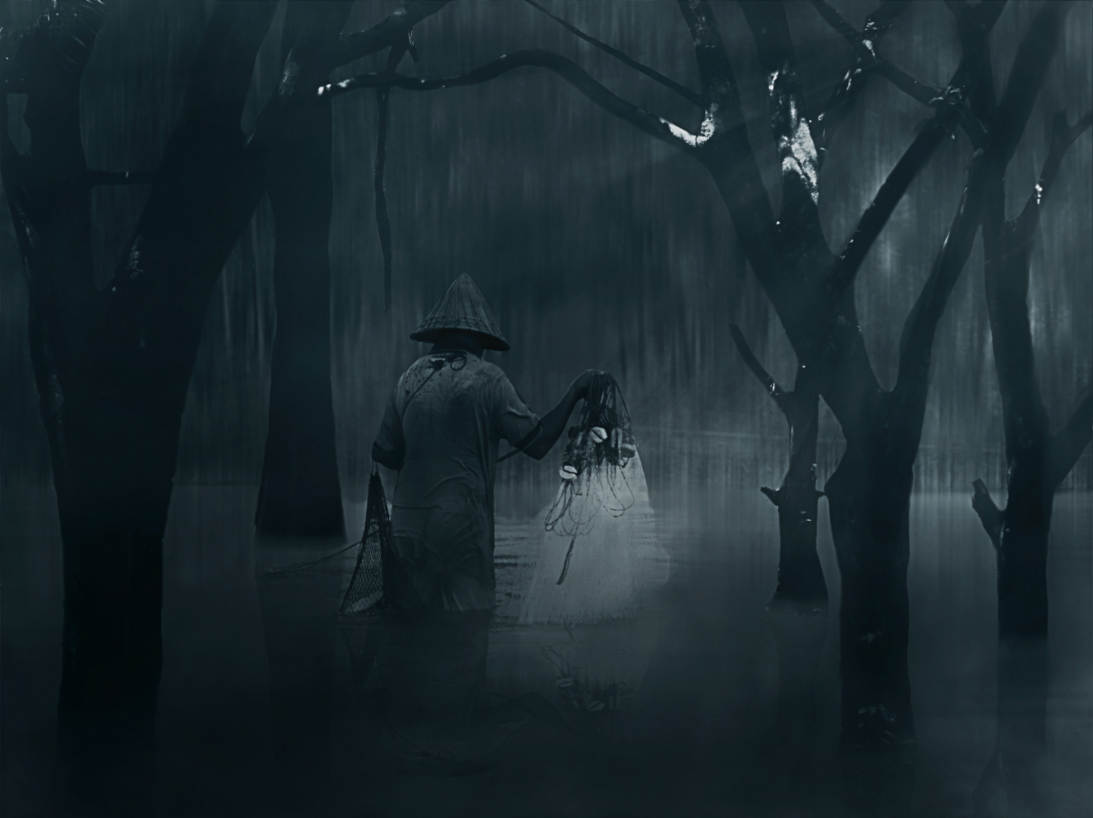
Adversary Strategy Thought Model
Strategic Aim – Pressure Points, Decisive Points, Centers of Gravity
Goals
Objectives
Constraints
Resources
Strategies
Tactics
Will
Co-evolution and Adaptation
Duality & pendulum
Adversary Wargaming
13 Element Sub-thought Model
Observed/observer Relationship
Advantages & disadvantages
Logic and Bias Errors; Enemies of Thinking
Inner circle of Decision-making
Proprietary Information and Private Property.
Property of Wayne Michael Hall. All Rights Reserved.
Copyright 2007, Wayne Michael Hall
iDruz Asyad
Mr. Who
500Pix.com_1601223
Purchased

Slide 10
Schema—An Adversary’s Thought Cycle
Think
Decide
Assess
Collect
Synthesize
Learn
Adapt
Perceive
Evaluate
Recompose
Observables
Act
Plan

Slide 11
The Book’s 22 Central Ideas
Proprietary Information and Private Property.
Property of Wayne Michael Hall. All Rights Reserved.
Copyright 2007, Wayne Michael Hall

Slide 12
Central Ideas
A primary acknowledgement—There exists, the constant appearance and influence on the course of human events of the hungry wolf of volition
14 elements of ‘will’ thought model
18 considerations of “will”
Mental combat—within the category—wars of ‘wits’
Wargaming adversary’s wargaming
Competing to be superior in recognizing and pursing that which truly matters
Operational context—4 kinds—this is different, but necessary view
Think like the adversary—his thinking mind, his mind’s eye, his apperception
Presence and influence of life-force
Need for thought leaders
Need for deep, relational thinking via visits to one’s high country and inner sanctum
Proprietary Information and Private Property.
Property of Wayne Michael Hall. All Rights Reserved.
Copyright 2007, Wayne Michael Hall

Slide 13
22 Central Ideas—cont.
Presence and influence of mass media and ‘will’
Movement and probabilities and potentialities in ‘shards’ of data via mass media
They move divided and influence when uniting or united
Deep think—synthesis, holism—imagination, creativity
Nonlinear operational contexts—duality and riding the wild pendulum in turbulence and change
Importance—recognize entwined moral and physical force in struggles over “will”
Scythe cuts—vertical domain silos and horizontal levels of conflict troughs
The wolf of volition’s ‘keep’ lays in resultant 28 cells—find, attack, attack again
COGs, decisive points, pressure points—struggles to dominate occur in cells
Fear of or disdain for alternatives
Four kinds of ‘strength’
Five kinds of ‘appearance’
Glide slope from passive to hyper-aggressive re appearance and presence of ‘will’
* See my draft, nascent explanation of Matrix War
Matrix War*
Next Slide
Proprietary Information and Private Property.
Property of Wayne Michael Hall. All Rights Reserved.
Copyright 2007, Wayne Michael Hall

Slide 14
Connections—COGs in Vertical Domain Silos
Air
Ground
Sea
Space
Cyber
Info
Cognition
Grand
Strategic:
Policy
Trough
I
Strategic:
Military
Trough
II
COGs in Levels of Conflict Troughs
Operational
Trough
III
Tactical
Trough
IV
Proprietary Information and Private Property.
Property of Wayne Michael Hall. All Rights Reserved.
Copyright 2017, Wayne Michael Hall

Slide 15
What Can Decision-makers Do?
Proprietary Information and Private Property.
Property of Wayne Michael Hall. All Rights Reserved.
Copyright 2007, Wayne Michael Hall

Slide 16
Decision-makers …
Read book—Reflections On “Will” How to Think Critically About “Will” in Complex Environments—internalize and use to win
Put your people through learning seminars re Reflections On “Will.”
Purposefully develop Über thinkers and thought pilgrims.
Learn ‘how to think’ about “will” to enable advantages to come to you.
Learn and use, as a minimum, these models of “will”…
14 essential elements of “will”
18 considerations of “will”
Duality
Ride the wild pendulum, and go to where conflict occurs—in the matrix.
Where fights over “will” occur and connectedness—Matrix War—28 cells.
Proprietary Information and Private Property.
Property of Wayne Michael Hall. All Rights Reserved.
Copyright 2007, Wayne Michael Hall

Slide 17
Decision-makers …
Understand/comprehend my 22 central ideas of “will” in which I propose theoretical acceptance and praxis.
Resolve internal/external contradictions within central ideas of “will” I propose.
Recognize and adjust to the nonlinear operational context in which competition occurs.
Wargame against your adversary’s wargaming.
Importance of ‘central ideas:’
Central ideas are foundational ideas—constitute the ‘core’ of rationale.
Organize around the 22 central ideas, “will’s” foundation.
Bring forth technology to support organizational design and central ideas.
Outthink your adversary—attack his plans at their inception.
Proprietary Information and Private Property.
Property of Wayne Michael Hall. All Rights Reserved.
Copyright 2007, Wayne Michael Hall

